Slide 1
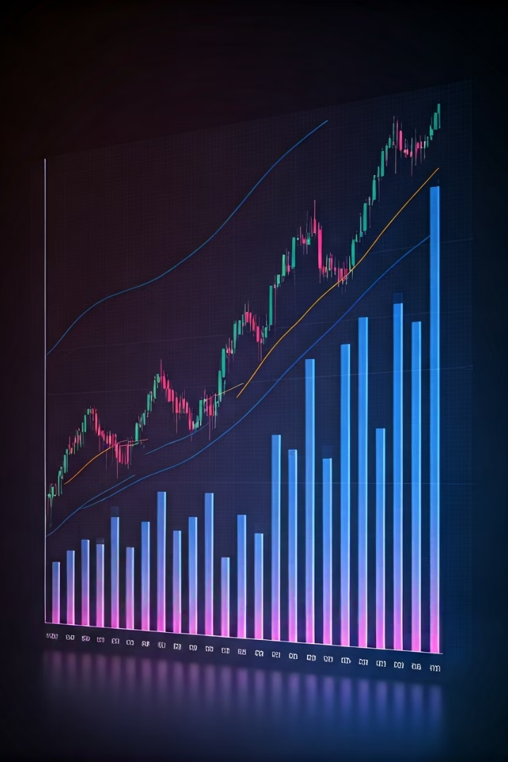


Sentiment-Managed Factor Portfolios
Dissertation by Aleksandr Mikhailov

Slide 2

Research question & Hypothesis
Research Question: Does market timing via use of news
sentiment improve performance of investment portfolios?
Research Hypothesis: Mean-Variance portfolios of MKT,
SMB, HML, RMW, CMA factors with their sentiment-managed
counterparts yield higher Sharpe Ratio out-of-sample than
unmanaged factor portfolios

Slide 3



Theoretical Background
Portfolio Management Theory
From the ancient 1/N portfolio to Markowitz's Mean-Variance Optimization and modern Parametric Portfolio Policy, portfolio theory has evolved to balance risk and return while addressing the "curse of dimensionality."
Volatility Management
Moreira and Muir (2017) showed that reducing exposure to factors during high volatility periods improves Sharpe ratios, as volatility changes aren't matched by proportional changes in expected returns.
Sentiment Analysis
The EPU indicator tracks mentions of 'Uncertainty', 'Volatility', and 'Economy' in news, serving as a proxy for market volatility and potentially improving factor portfolio performance.

Slide 4
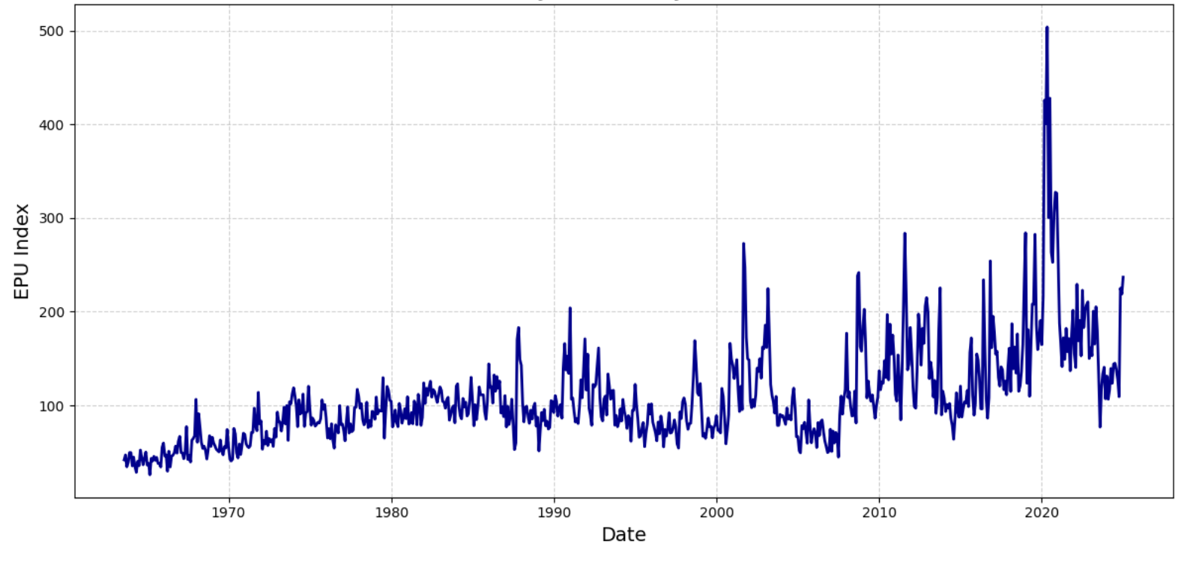
Data Description
Factor Data
EPU Indicator
The research uses Fama-French 5 factor data from 1963 to 2024, including market factor (MKT), small-minus-big (SMB), high-minus-low (HML), robust-minus-weak (RMW), and conservative-minus-aggressive (CMA).
The Economic Policy Uncertainty (EPU) indicator measures uncertainty using the frequency of 'Uncertainty', 'Volatility', and 'Economy’ word mentions across 11 newspapers. Spikes correspond to economic events like the 2008 financial crisis, COVID-19 pandemic, and Trump tariffs.
Factor | μ (in %, annual) | σ (in %, annual) | Max (in %) | Min (in %)
MKT | 7.078 | 16.185 | 11.3 | -17.4
SMB | 1.592 | 8.74 | 6.2 | -11.2
HML | 3.466 | 9.3 | 6.7 | -5
RMW | 3.482 | 6.376 | 4.5 | -3
CMA | 3.04 | 6.041 | 2.5 | -5.9

Slide 5
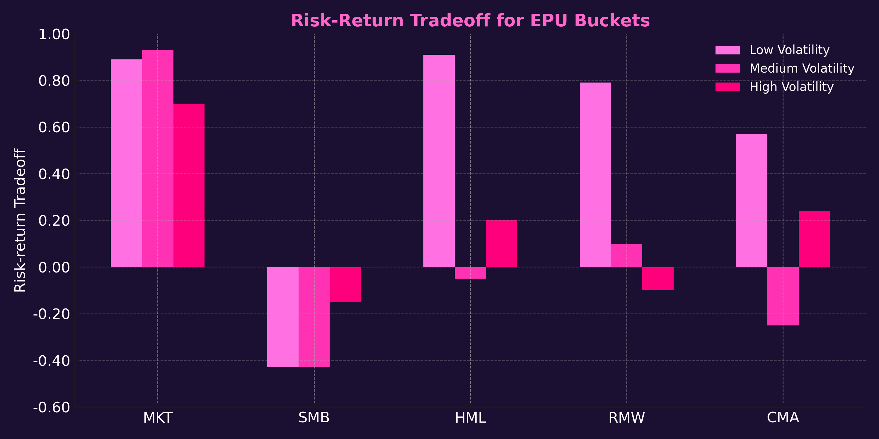
Empirical Test
The empirical test shows that risk-return relationship weakens with rising uncertainty in news sentiment. By breaking data into terciles based on EPU values, we observe that additional risk taken during high uncertainty periods is not rewarded.

Slide 6
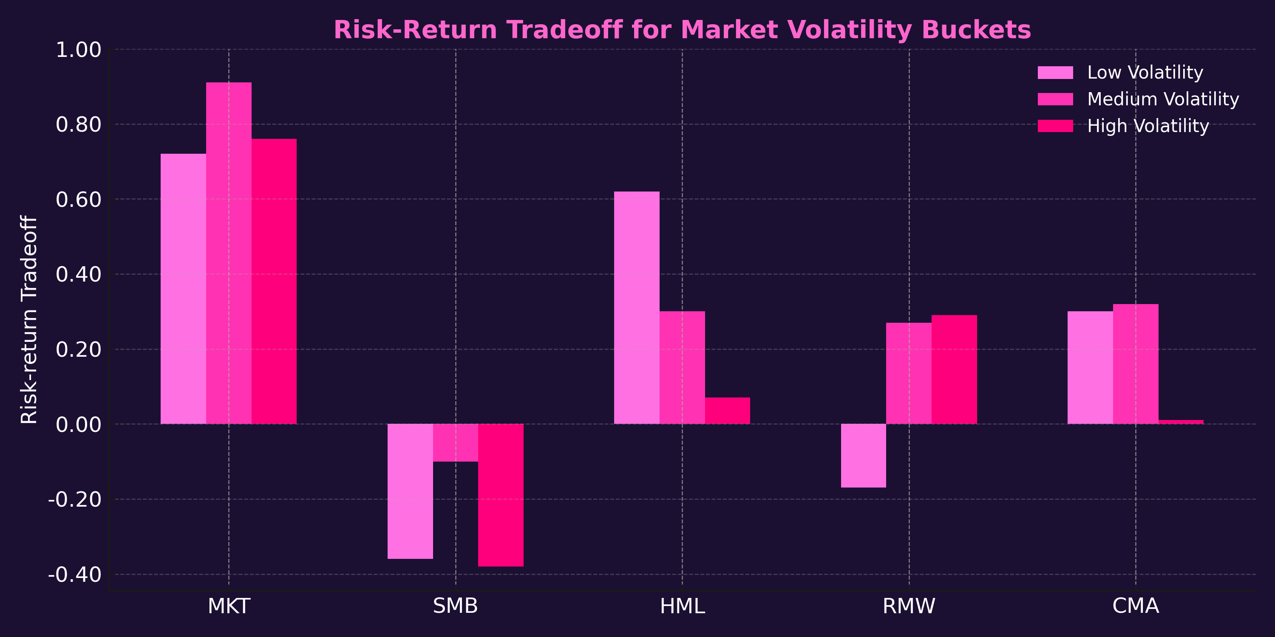
Empirical Test
Similar patterns appear when factors are sorted by market volatility, though the effects are less pronounced than with EPU-sorted buckets. This suggests that sentiment timing may be more relevant than volatility timing for portfolio optimization.

Slide 7
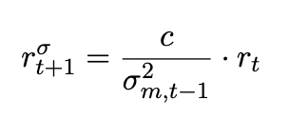
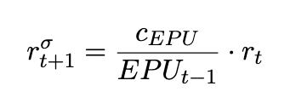
Methodology
3
2
1
Performance Assessment
Portfolio Optimization
Performance is evaluated using Annualized Sharpe Ratios, showing risk-adjusted return after subtracting the risk-free rate. Statistical significance of Sharpe Ratio differences is tested via the Ledoit-Wolf Z-test.
Factor Construction
Mean-variance portfolios are constructed combining: 1) volatility-managed factor, pure factor, and risk-free fund; and 2) sentiment-managed factor, pure factor, and risk-free fund.
Volatility-managed factors are created by scaling factor performance by the inverse of its market volatility for the previous month. Similarly, sentiment-managed factors are scaled by the inverse of the EPU indicator.
The optimization includes no-shortselling constraints, with weights summing to 1, using the scipy.optimize package for Python.
The scaling parameters are found by minimizing the difference between standard deviations of factor returns, calculated out-of-sample to ensure a realistic approach.

Slide 8
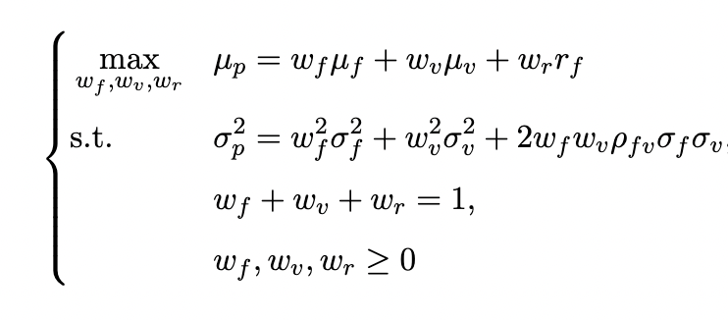
Methodology
3
1
2
Performance Assessment
Factor Construction
Performance is evaluated using Annualized Sharpe Ratios, showing risk-adjusted return after subtracting the risk-free rate. Statistical significance of Sharpe Ratio differences is tested via the Ledoit-Wolf Z-test.
Portfolio Optimization
Volatility-managed factors are created by scaling factor performance by the inverse of its market volatility for the previous month. Similarly, sentiment-managed factors are scaled by the inverse of the EPU indicator.
2 types of Mean-variance portfolios are constructed by combining:
volatility-managed factor, pure factor, and risk-free fund; and
sentiment-managed factor, pure factor, and risk-free fund.
The scaling parameters are found by minimizing the difference between standard deviations of factor returns, calculated out-of-sample to ensure a realistic approach.
The optimization includes no-shortselling constraints, with weights summing to 1

Slide 9
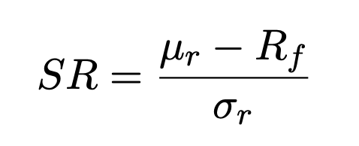
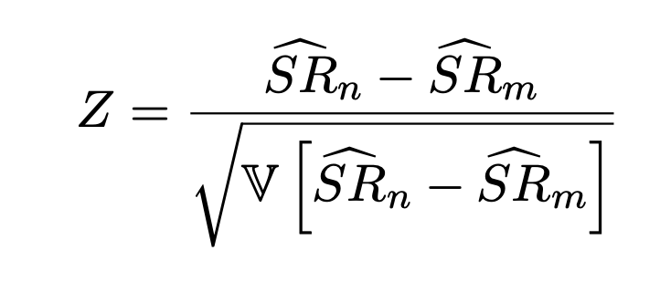
Methodology
1
3
Factor Construction
Performance Assessment
Volatility-managed factors are created by scaling factor performance by the inverse of its market volatility for the previous month. Similarly, sentiment-managed factors are scaled by the inverse of the EPU indicator.
Performance is evaluated using Annualized Sharpe Ratios, showing risk-adjusted return after subtracting the risk-free rate. Statistical significance of Sharpe Ratio differences is tested via the Ledoit-Wolf Z-test.
The scaling parameters are found by minimizing the difference between standard deviations of factor returns, calculated out-of-sample to ensure a realistic approach.

Slide 10
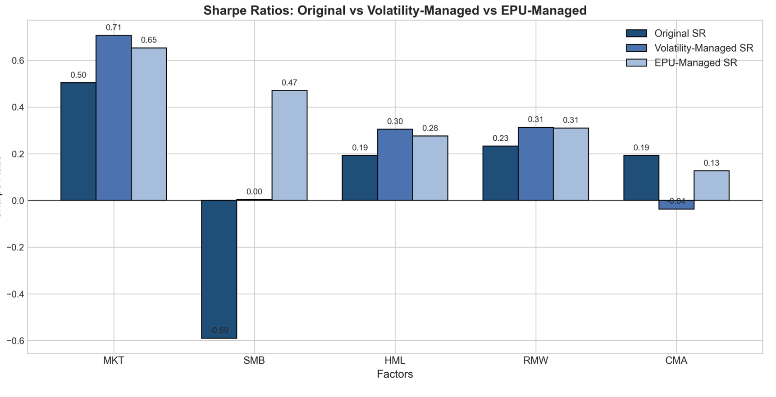
Empirical Findings: Factor Performance
The results indicate that both volatility management and sentiment management improve the risk-adjusted performance of most factors. For the market factor (MKT), the Sharpe Ratio increases from 0.50 to 0.71 with volatility management and to 0.65 with EPU management.
Sentiment-managed factors appear to be more stable than volatility-managed factors. This is clearly indicated by SMB and CMA factors

Slide 11
Statistical Significance
Factor
SR (EPU-Managed)
p-value
SR (Volatility-Managed)
p-value
MKT
0.59
0.09 (*)
1.69
0.09 (*)
SMB
-2.31
0.06 (*)
1.90
0.06 (*)
HML
0.28
0.35
0.93
0.35
RMW
0.02
0.27
1.11
0.27
CMA
-1.08
0.39
-0.87
0.39
The Ledoit-Wolf test of SR difference between managed and unmanaged portfolios results shows statistically significant improvements in Sharpe Ratios for both EPU-managed and volatility-managed portfolios for the market and SMB factors at the 10% confidence level.
For the remaining factors (HML, RMW, and CMA), the differences in Sharpe Ratios under both management approaches are positive but not statistically significant at conventional levels. This statistical insignificance may be partly explained by the Ledoit-Wolf test's assumption of normally distributed returns, which is not always the case in practice.

Slide 12
Conclusions and Future Research
Key Findings
Theoretical Implications
Future Research
Both volatility-managed and sentiment-managed factor portfolios consistently outperform their unmanaged equivalents in terms of Sharpe Ratios. The improvements are particularly significant for the Market and SMB factors.
The results support the ARCH effect theory, which implies that conditional volatility and sentiment can serve as effective timing signals for portfolio management.
Future studies should incorporate transaction costs into the optimization process, reconstruct factor returns manually to reduce survivorship bias, and apply the model across different countries to assess its robustness.
The study extends previous research of Moreira & Muir by showing that macroeconomic state variables such as EPU can also serve as effective timing instruments.
The Parametric Portfolio Policy framework offers mechanisms to account for transaction costs by recognizing offsetting trades across factor loadings.
EPU-managed portfolios perform more stable comparably to volatility-managed portfolios, suggesting that EPU may serve as an effective proxy for market risk or uncertainty.

